Slide 1
MULTI-AGENT PATH PLANNING
Anchita Goel(2012019)
Sarthak Ahuja(2012088)

Slide 2

Problem Statement
A grid map warehouse
Many agents
Transport items to destined location
No colliding
Source: http://ep.yimg.com/ay/yhst-77452660007630/robot-butler-4.gif

Slide 3
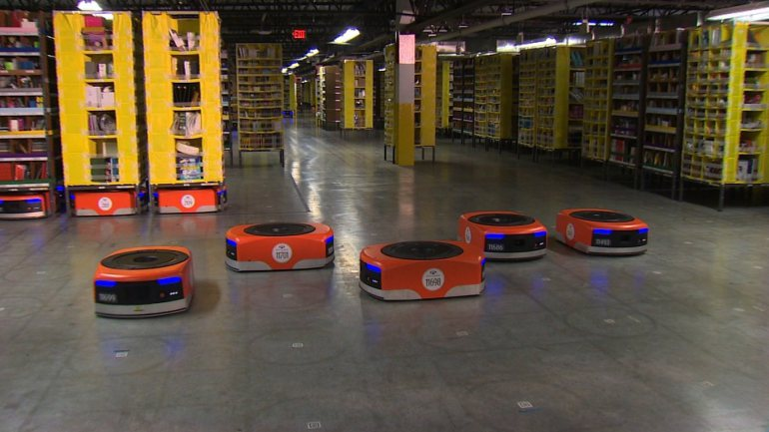
MOTIVATION
Warehouse Butlers
Source: http://wtkr.com/2014/12/01/amazon-deploys-army-of-robots-in-its-next-gen-warehouses/

Slide 4
NOT SO POPULAR APPROACHES
Use Centralized A* - NO
Use Local Repair A*
Imagine what would happen if you asked everyone in your office to choose a new desk? BLINDFOLDED.
Each time they collide, they might re-plan and select a new route.
But this won’t prevent further collisions.
If your office is spacious and sparsely populated, then OK.
But the whole process can degenerate into a never-ending cycle of collisions and replanning.
This search ignores the presence of other units, or perhaps treats them as stationary obstacles. If a collision is imminent, the units involved will re-search and select a new path.
Cooperative pathfinding attempts to remove the blindfolds.
A* search is still used, but in a way that takes account of other units’ movements.

Slide 5
ONE OF THE State of the Art AlgorithmS
MAPP by Ko-Hsin Cindy Wang and Adi Botea
Doesn’t guarantee optimality and completeness for all problems. Neither do the others.
But - complete over SLIDABLE instances

Slide 6
ORIGIN OF THE IDEA
MAPP keeps its running costs low by eliminating the need for replanning.
Sliding Tile Problems – Need a blank to make a next move.
If blank is not there? Bring the blank there.

Slide 7
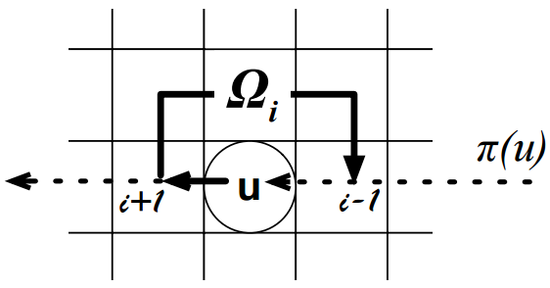
SLIDABLE instances
Satisfy three conditions
Initial Blank
Alternating Connectivity
Target Isolation
Use basic A* with Manhattan distance as heuristic for path finding
How do you move? Who goes first?
Source: http://ijcai.org/papers09/Papers/IJCAI09-310.pdf

Slide 8
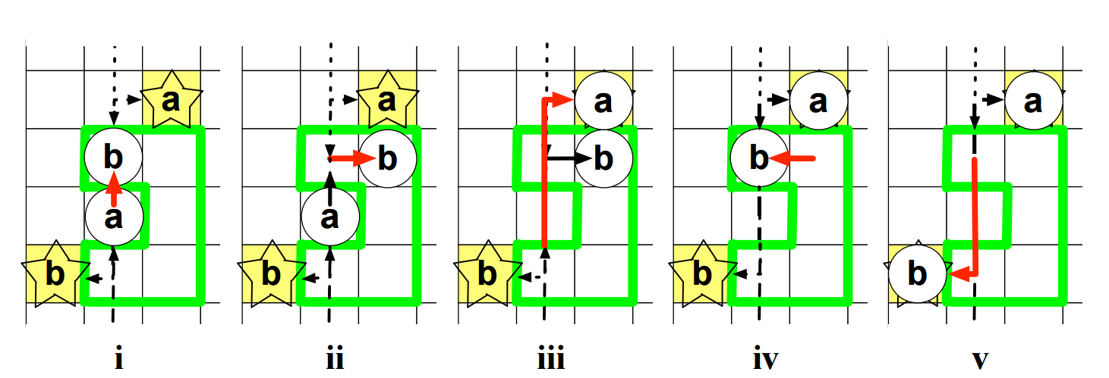
MAPP
The sequence of moves decided by the priorities of the butlers.
Lower priority butler may have to move to make space for higher priority butler if in its way.
Source: http://ijcai.org/papers09/Papers/IJCAI09-310.pdf

Slide 9
ALGORITHM
The sequence of moves decided by the priorities of the butlers.
Lower priority butler may have to move to make space for higher priority butler if in its way.
Source: http://ijcai.org/papers09/Papers/IJCAI09-310.pdf

Slide 10
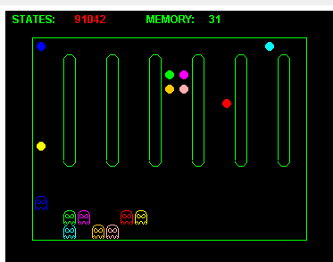
Demonstration
A snapshot from our implementation

Slide 11
CONCLUSION
For a warehouse scenario:
Best to have known combination of items in different isles.
Have at least a single length Channel free between adjacent Item Walls.
Spacing the Workstations
Having a circular distribution of targets

Slide 12
Deliverables
A working simulation of multiple butlers moving around in a warehouse following the constraints laid by us.
Provide customizable parameters to experiment and evaluate the results.
Provide a detailed log which reports usage of memory and other resources and states in each experimental setup.
An evaluation of cases where the algorithm fails to find a solution at all.

Slide 13
FUTURE WORK
Add Relaxations for certain cases:
Target Isolation
Alternate Connectivity
Add a dynamic model to plan the path back to the workstation.
A Static Approach would be allow all the butlers to reach their goals and then run the algorithm again with the initial goals as the new source positions and vice versa.
Can we do better?

Slide 14
POPULAR APPROACHES
Using RRT - Rapidly-exploring Random Trees
Vishnu R. Desaraju and Jonathan P. How, Decentralized Path Planning for Multi-Agent Teams in Complex Environments using Rapidly-exploring Random Trees
Grows RRT at instances of
WHCA* - Windowed Hierarchical Cooperative A*
David Silver, Cooperative Pathfinding
Reserves initial steps of an agent.
FAR - Flow Annotation Replanning
Ko-Hsin Cindy Wang and Adi Botea
Converts the scene into a flow network and runs A*. Later resolves deadlocks.

